Slide 1
Operations Management
By Tanmoy Das
Industrial Engineer
Certified Six Sigma Green Belt from ASQ

Slide 2
Work Study

Slide 3
Outline of Work Study
A. Methods analysis (e.g., charting, workstation design, motion economy) B. Time study (e.g., time standards, allowances) C. Predetermined time standard systems (e.g., MOST, MTM) D. Work sampling E. Learning curves

Slide 4
Work study
Work study may be defined as the analysis of a job for the purpose of finding the preferred method of doing it and also determining the standard time to perform it by the preferred (or given) method. Work study, therefore, comprises of two areas of study: method study (motion study) and time study (work measurement).
Work Study
Method Study
Work Measurement
Stop watch time study
Work Sampling
Predetermined Data

Slide 5
A. Methods analysis (e.g., charting)

Slide 6
A. Methods analysis (e.g. workstation design)

Slide 7
A. Methods analysis (e.g. motion economy)
motion study: Systematic study of the human motions used to perform an operation.

Slide 8
B. Time study (e.g., time standards, allowances)
Work measurement: determining how long it ought to take to perform a job
A standard time is the amount of time it should take a qualified worker to complete a specified task, working at a sustainable rate, using given methods, tools and equipment, raw material inputs, and workplace arrangement
The basic steps in a time study are: 1. Define the task to be studied, and inform the worker who will be studied. 2. Determine the number of cycles to observe. 3. Time the job, and rate the worker's performance. 4. Compute the standard time

Slide 9
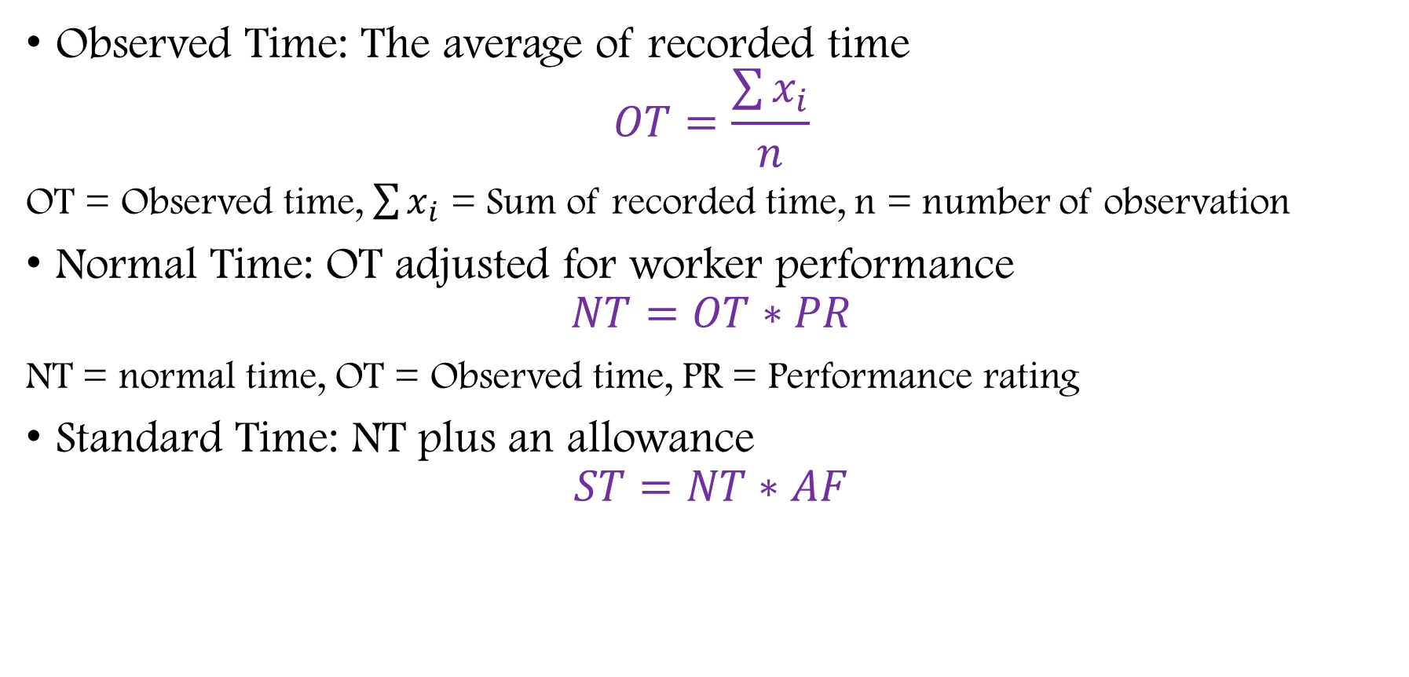
B. Time study (e.g., time standards, allowances)
Observed Time: The average of recorded time
$$OT=\frac{\sum{x_{i}}}{n}$$
OT = Observed time, $\sum{x_{i}}$ = Sum of recorded time, n = number of observation
Normal Time: OT adjusted for worker performance
$$NT=OT∗PR$$
NT = normal time, OT = Observed time, PR = Performance rating
Standard Time: NT plus an allowance
$$ST=NT∗AF$$
Notes:
ONS3.10
3.05
3.10
3.08
3.12
3.15
3.12
3.08
3.05
3.10
3.10
3.05
3.10
3.08
3.12
3.15
3.12
3.08
3.05
3.10

Slide 10
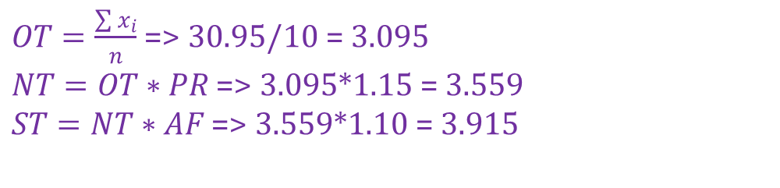
B. Time study (e.g., time standards, allowances)
An industrial engineer conducted a time study of an assembly operation with the times given. The engineer gave a performance rating of 115. The allowance factor is 10% of job time. The standard time for this operation is most nearly: A. 2.96 B. 3.20 C. 3.56 D. 3.92
Observation | Time
1 | 3.10
2 | 3.05
3 | 3.10
4 | 3.08
5 | 3.12
6 | 3.15
7 | 3.12
8 | 3.08
9 | 3.05
10 | 3.10
$OT=\frac{\sum{x_{i}}}{n}$ => 30.95/10 = 3.095
$NT=OT∗PR$ => 3.095*1.15 = 3.559
$ST=NT∗AF$ => 3.559*1.10 = 3.915

Slide 11

A time study analyst timed an assembly operation for 30 cycles, and computed the time per cycle, which was 18.75 minutes. The analyst assigned a performance rating of .96,<11;'(& decided that an appropriate allowance was 15 percent-Assume the allowance factor is based on the workday. Determine the following: the observed time, the normal time (NT), and the standard time (ST).

Slide 12
C. Predetermined time standard systems (e.g., MOST)
MOST stands for Maynard operation Sequence technique. It is one of the important work measurement technique used for decisions making.

Slide 13
C. Predetermined time standard systems (e.g. MTM - Method time measurement)
the analyst must divide the job into its basic elements (reach, move, turn, disengage), measure the distances involved (if applicable), rate the difficulty of the element, and then refer to the appropriate table of data to obtain the time for that element.
The standard time for the job is obtained by adding the times for all of the basic elements. Times of the basic elements are measured in time measurement units (TMUs); one TMU equals .0006 minute.

Slide 14
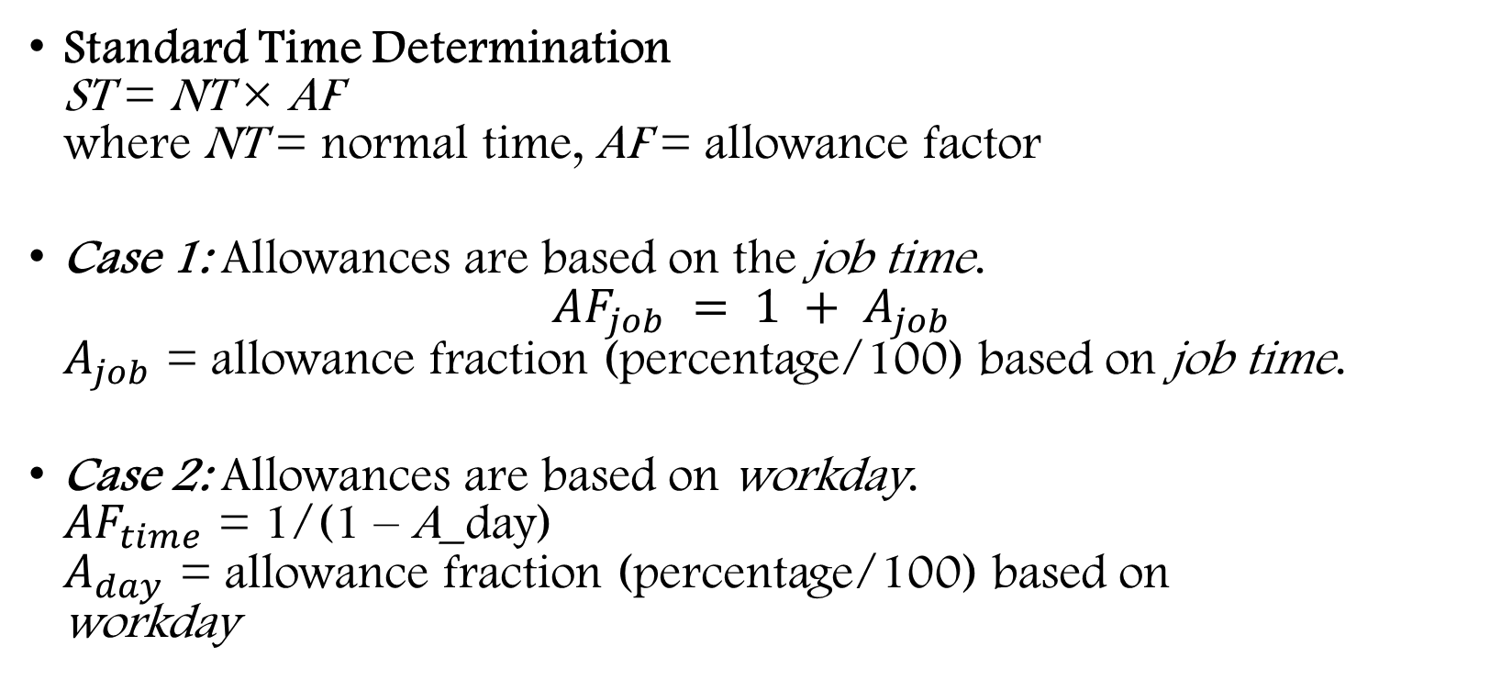
Standard Time Determination ST = NT × AF where NT = normal time, AF = allowance factor
Case 1: Allowances are based on the job time. $AF_{job} = 1 + A_{job}$ $A_{job}$ = allowance fraction (percentage/100) based on job time.
Case 2: Allowances are based on workday. $AF_{time}$ = 1/(1 – A_day) $A_{day}$ = allowance fraction (percentage/100) based on workday

Slide 15
Predetermined time systems are useful in cases where either (1) the task does not yet exist or (2) changes to a task are being designed and normal times have not yet been established for all elements of the new task or changed task. In such cases no opportunity exists to measure the element time.
Unfortunately, there is no scientific basis for predicting element times without breaking them down into motion-level parts. A task consists of elements. An organization may develop its own database of normal element durations, and normal times for new or changed tasks may be predicted if the tasks consist entirely of elements whose normal times are already in the database.
But new elements can be decomposed into motions, for which scientifcally predetermined times exist in databases called MTM-1, MTM-2, and MTM-3. These databases and software to manipulate them are commercially available. To use one of them effectively requires about 50 hours of training

Slide 16

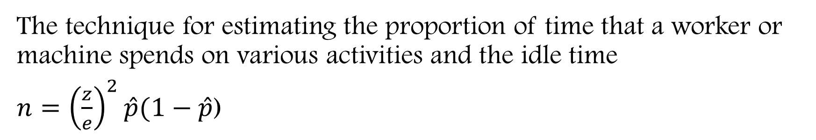
D. Work sampling
The technique for estimating the proportion of time that a worker or machine spends on various activities and the idle time
$n={\left(\frac{z}{e}\right)}^{2}\hat{p}(1−\hat{p}$)
Notes:
p332

Slide 17
The procedure of work sampling
Clearly identify the worker(s) or machine(s) to be studied.
Notify the workers and supervisors of the purpose of the study to avoid arousing suspicions.
Compute an initial estimate of sample size using a preliminary estimate of p, if available (e.g., from analyst experience or past data). Otherwise, use p = .50.
Develop a random observation schedule.
Begin taking observations. Re-compute the required sample size several times during the study.
Determine the estimated proportion of time spent on the specified activity

Slide 18
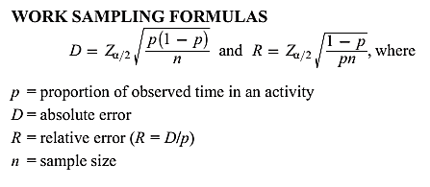
Source: FE – Industrial Specific

Slide 19
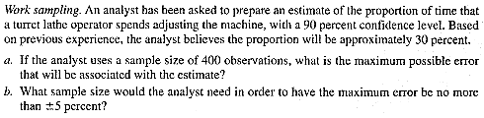
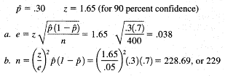

Slide 20
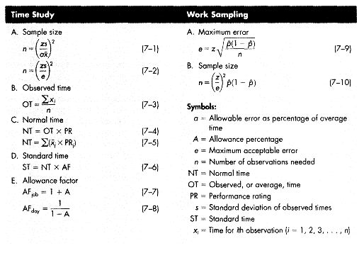

Slide 21
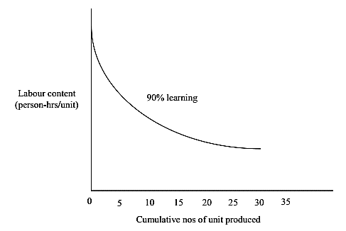
E. Learning curves
Human performance of activities typically shows improvement when the activities are done on a repetitive basis: The time required to perform a task decreases with increasing repetitions. Learning curves summarize this phenomenon

Slide 22
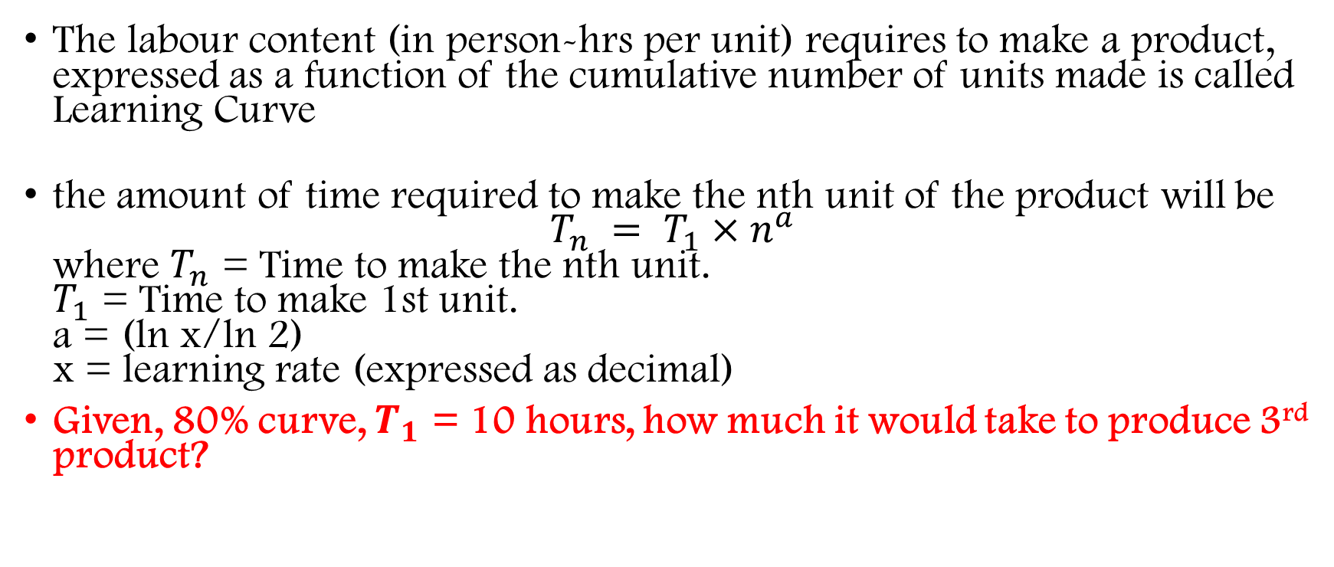
Learning Curve
The labour content (in person-hrs per unit) requires to make a product, expressed as a function of the cumulative number of units made is called Learning Curve
the amount of time required to make the nth unit of the product will be $T_{n} = T_{1}×n^{a}$ where $T_{n}$ = Time to make the nth unit. $T_{1}$ = Time to make 1st unit. a = (ln x/ln 2) x = learning rate (expressed as decimal)
Given, 80% curve, $T_{1}$ = 10 hours, how much it would take to produce 3rd product?

Slide 23
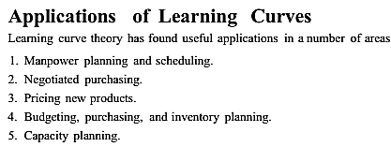

Slide 24
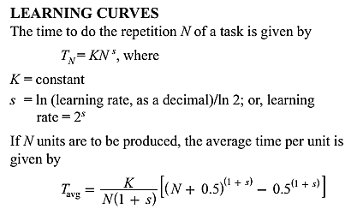
Source: Fundamental Engineering – Industrial Specific

Slide 25
Aggregate Planning

Slide 26
Aggregate Planning definition
The aggregate planning concentrates on scheduling production, personnel and inventory levels during intermediate term planning horizon such as 3-12 months.
Aggregate plans act as an interface between strategic decision (which fixes the operating environment) and short term scheduling and control decision which guides firm’s day-to-day operations.

Slide 27
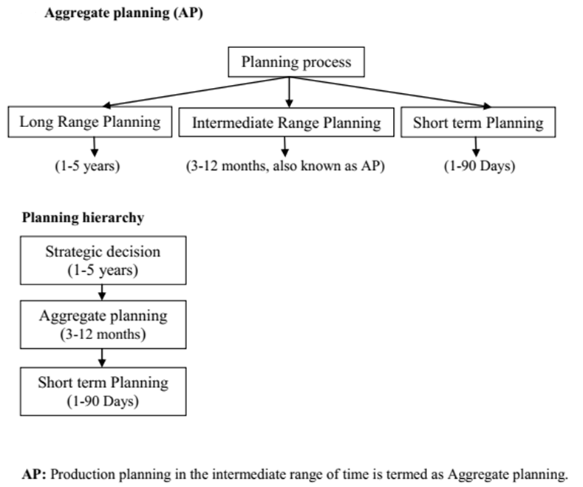

Slide 28
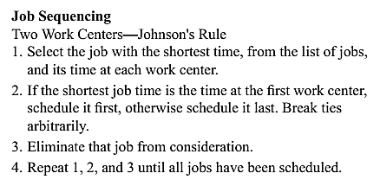
Johnson’s Rule
Johnson's rule is a method of scheduling jobs in two work centers. Its primary objective is to find an optimal sequence of jobs to reduce makespan (the total amount of time it takes to complete all jobs). It also reduces the amount of idle time between the two work centers. The method minimizes the makespan in the case of two work centers.

Slide 29
MRP

Slide 30
MPS

Slide 31
BoM

